Slide 1
Process

Slide 2
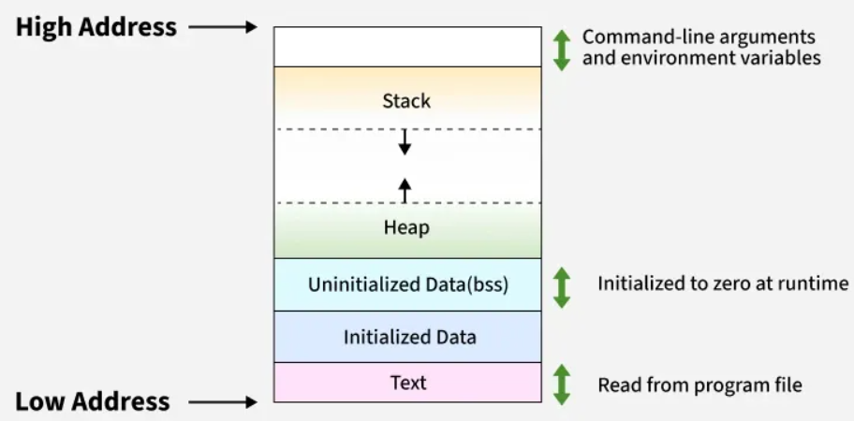
Memory Layout of a process

Slide 3
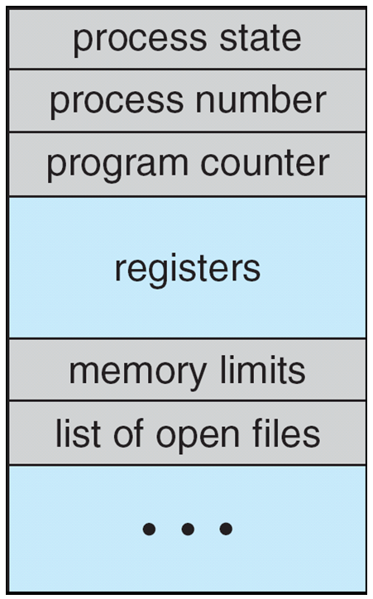
Process Control Block (PCB)
Information associated with each process
(also called task control block)
Process state – running, waiting, etc
Program counter – location of instruction to next execute
CPU registers – contents of all process-centric registers
CPU scheduling information- priorities, scheduling queue pointers
Memory-management information – memory allocated to the process
Accounting information – CPU used, clock time elapsed since start, time limits
I/O status information – I/O devices allocated to process, list of open files

Slide 4

CPU Switch From Process to Process

Slide 5
Process Scheduling
Maximize CPU use, quickly switch processes onto CPU for time sharing
Process scheduler selects among available processes for next execution on CPU
Maintains scheduling queues of processes
Job queue – set of all processes in the system
Ready queue – set of all processes residing in main memory, ready and waiting to execute
Device queues – set of processes waiting for an I/O device
Processes migrate among the various queues

Slide 6
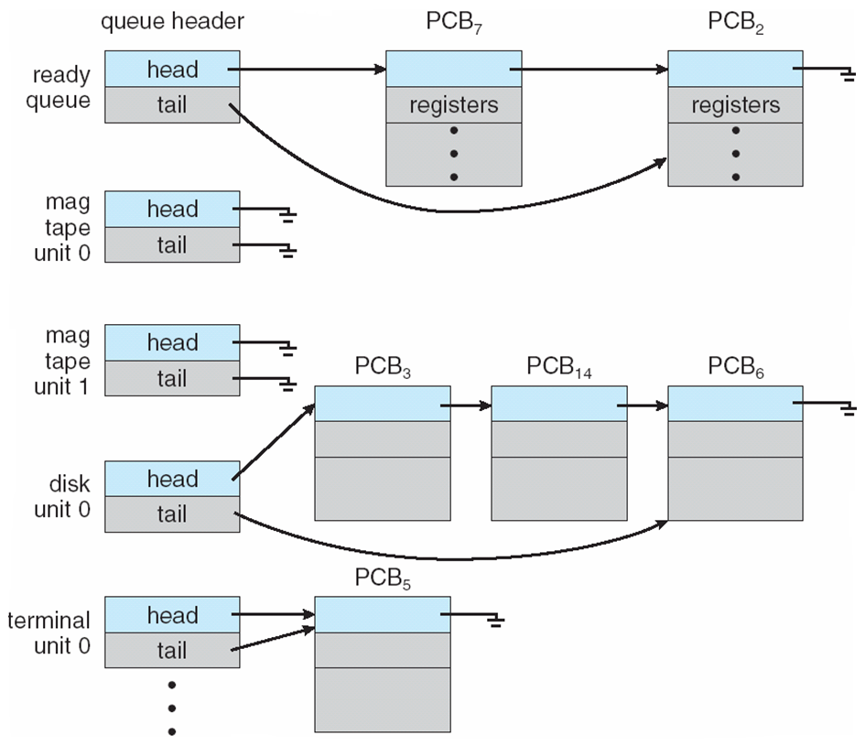
Ready Queue And Various I/O Device Queues

Slide 7
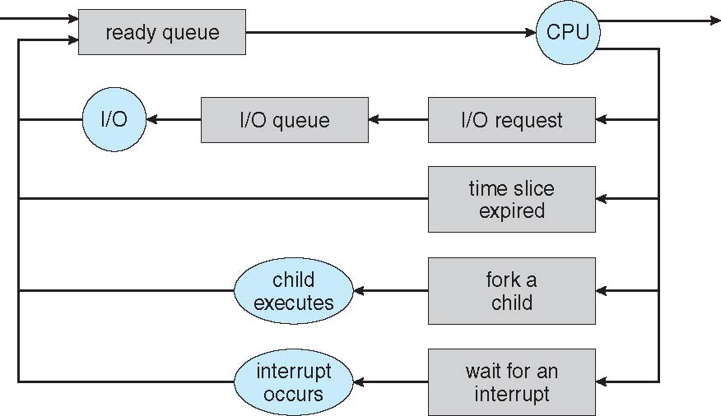
Representation of Process Scheduling
Queueing diagram represents queues, resources, flows

Slide 8
Schedulers
Short-term scheduler (or CPU scheduler) – selects which process should be executed next and allocates CPU
Sometimes the only scheduler in a system
Short-term scheduler is invoked frequently (milliseconds) ⇒ (must be fast)
Long-term scheduler (or job scheduler) – selects which processes should be brought into the ready queue
Long-term scheduler is invoked infrequently (seconds, minutes) ⇒ (may be slow)
The long-term scheduler controls the degree of multiprogramming
Processes can be described as either:
I/O-bound process – spends more time doing I/O than computations, many short CPU bursts
CPU-bound process – spends more time doing computations; few very long CPU bursts
Long-term scheduler strives for good process mix

Slide 9
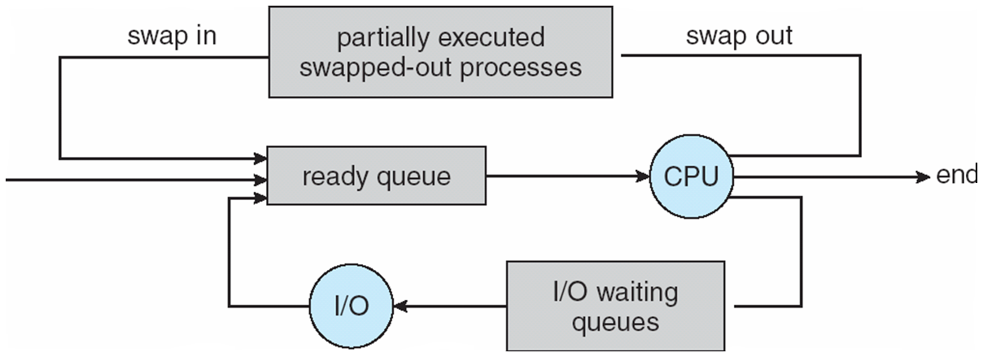

Slide 10
Context Switch
When CPU switches to another process, the system must save the state of the old process and load the saved state for the new process via a context switch
Context of a process represented in the PCB
Context-switch time is overhead; the system does no useful work while switching
The more complex the OS and the PCB ➔ the longer the context switch

Slide 11
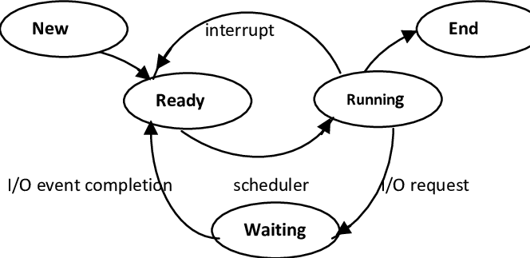
Process States(LIFE CYCLE)

Slide 12
1)
#include <stdio.h>
#include <stdlib.h>
int a = 5;
static int b;
int main() {
int c = 10;
int *p = (int*)malloc(sizeof(int));
return 0;
}
In which memory section will each of the following be stored?
a
b
c
pointer p
memory allocated by malloc

Slide 13
2) A process contains the sections: Text, Initialized Data, BSS, Heap, and Stack. Match each section with its property:
Section | Property
(i) Text | (a) Grows upward/downward dynamically, stores local variables
(ii) Data | (b) Stores global variables explicitly initialized in code
(iii) BSS | (c) Stores global/static variables not initialized by programmer
(iv) Heap | (d) Contains compiled machine instructions, read-only
(v) Stack | (e) Allocated at runtime using malloc/new

Slide 15
3) Given the following processes with their times and priority (lower number indicates higher priority) . Compute average waiting time using priority scheduling algorithm?
PID | BT | Priority
P1 | 10 | 3
P2 | 1 | 1
P3 | 2 | 4
P4 | 1 | 5
P5 | 5 | 2

Slide 16
Operations on Processes
System must provide mechanisms for:
process creation,
process termination

Slide 17
Process Creation
Parent process create children processes, which, in turn create other processes, forming a tree of processes
Generally, process identified and managed via a process identifier (pid)
Resource sharing options
Parent and children share all resources
Children share subset of parent’s resources
Parent and child share no resources
Execution options
Parent and children execute concurrently
Parent waits until children terminate

Slide 18
A Tree of Processes in Linux

